Slide 1
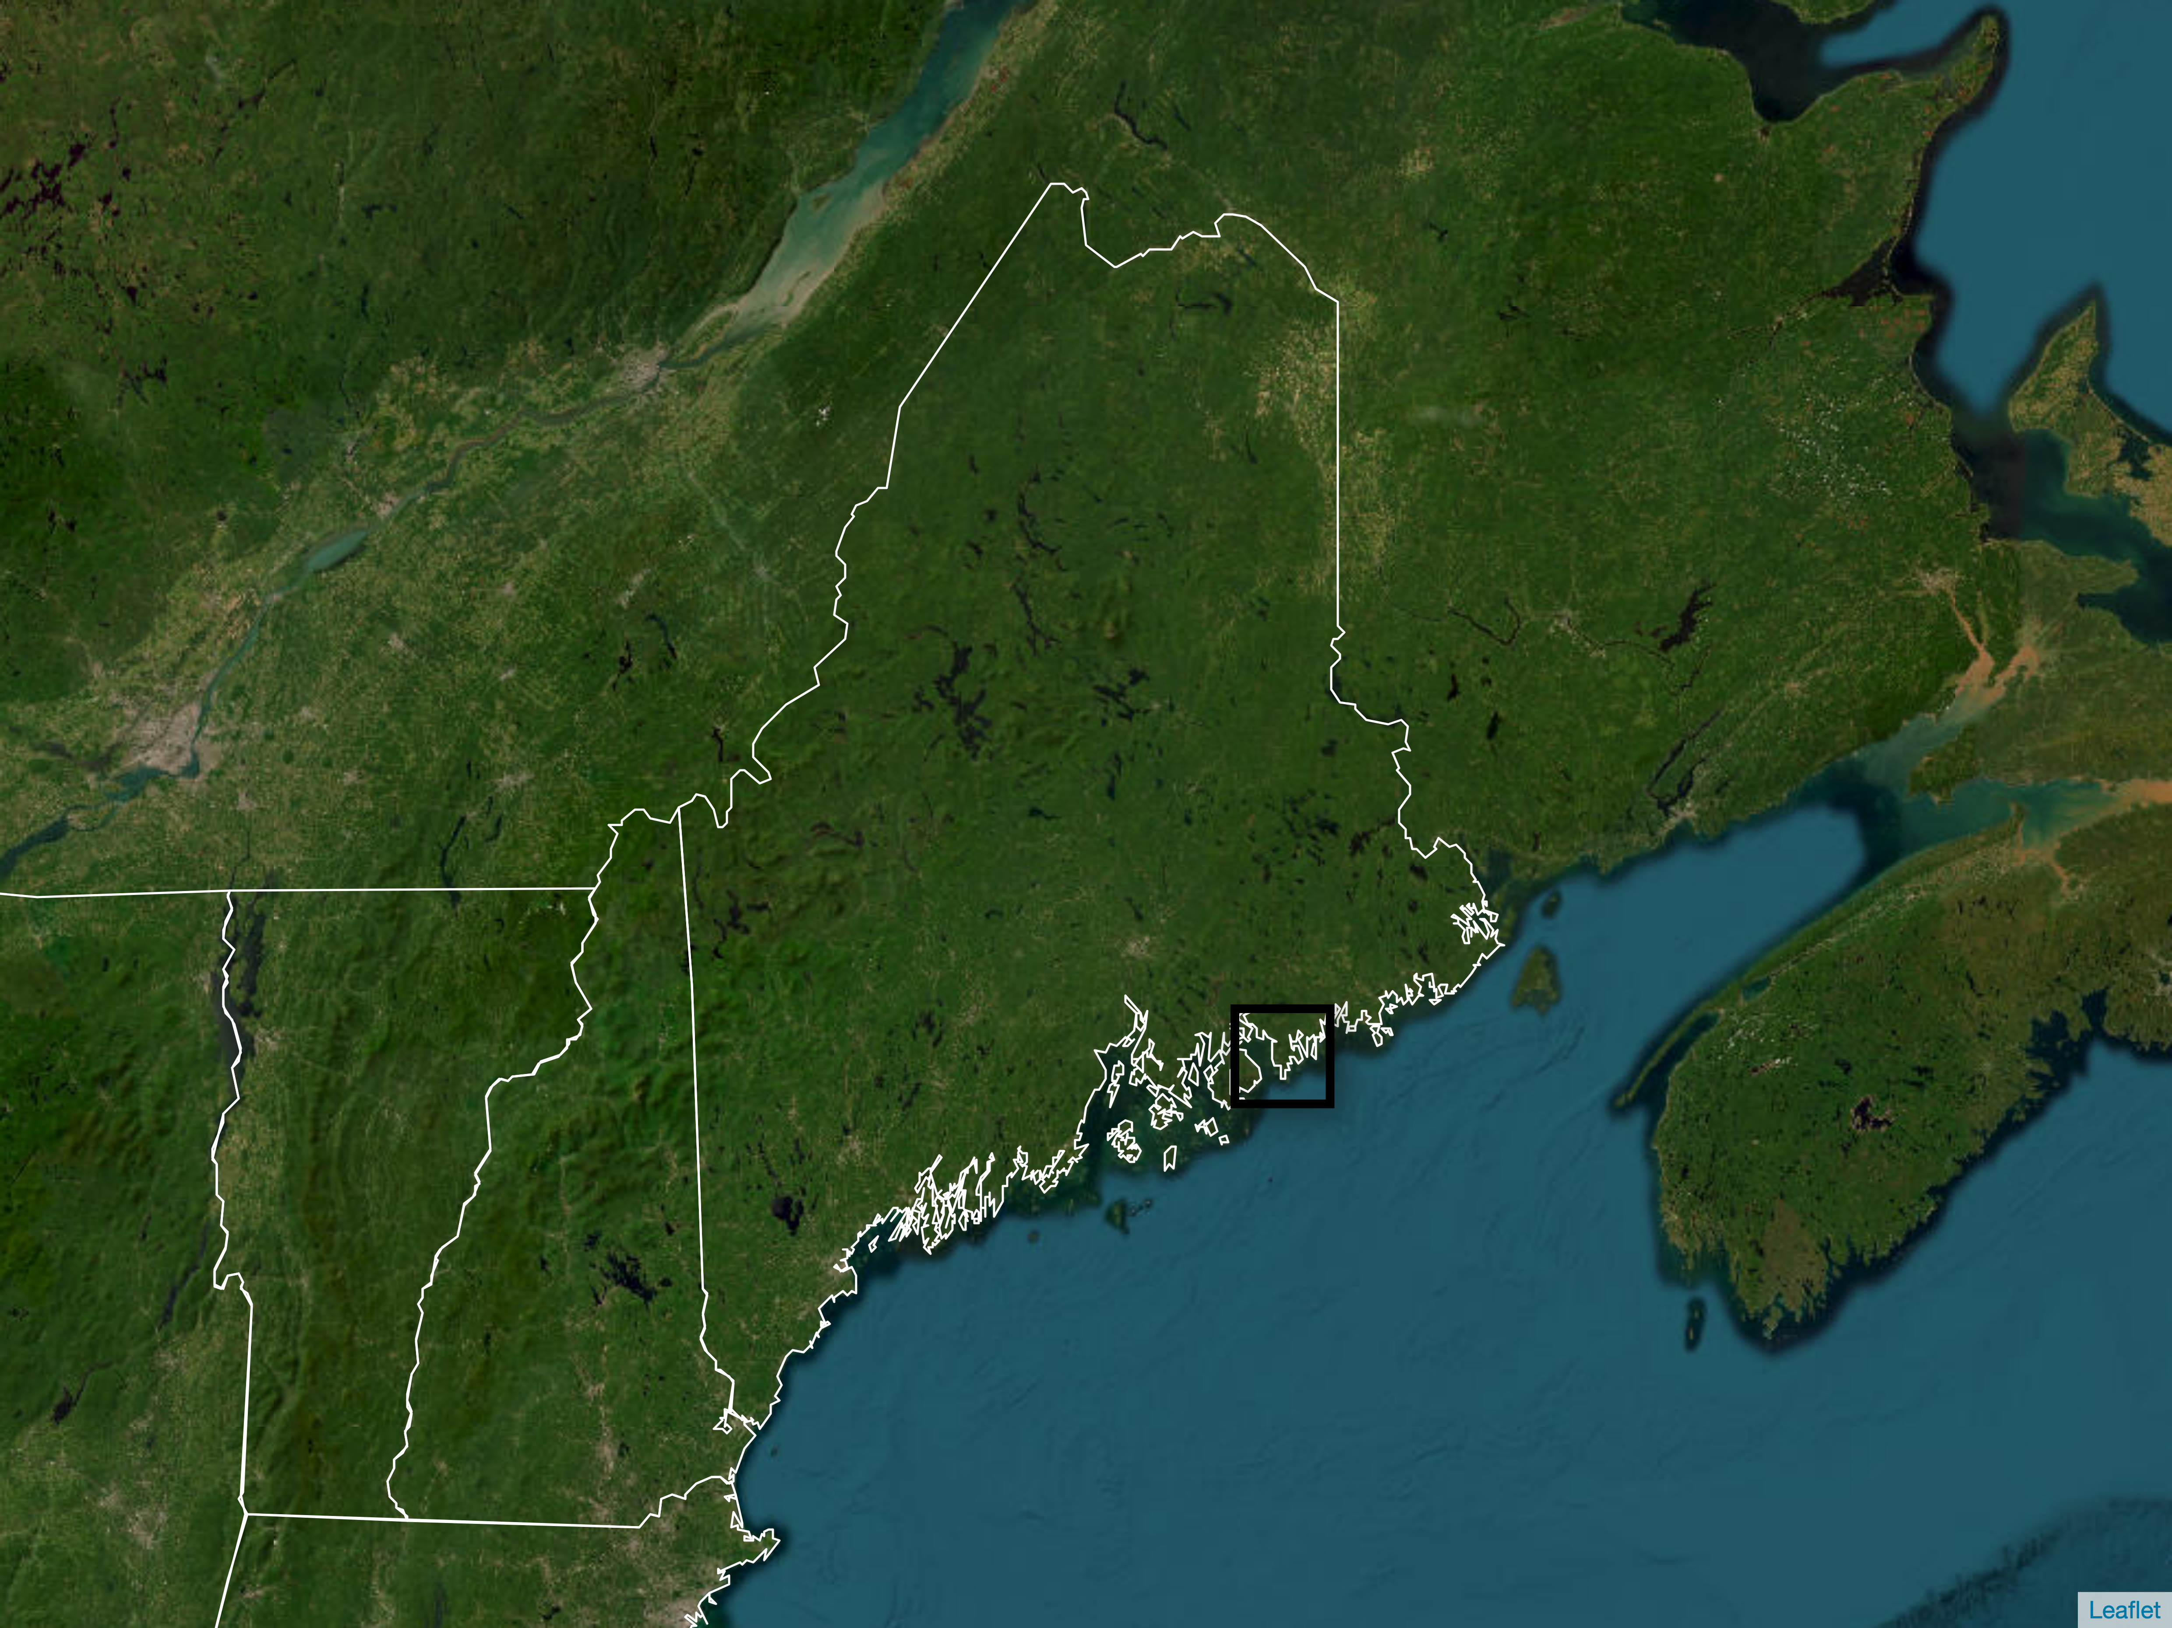
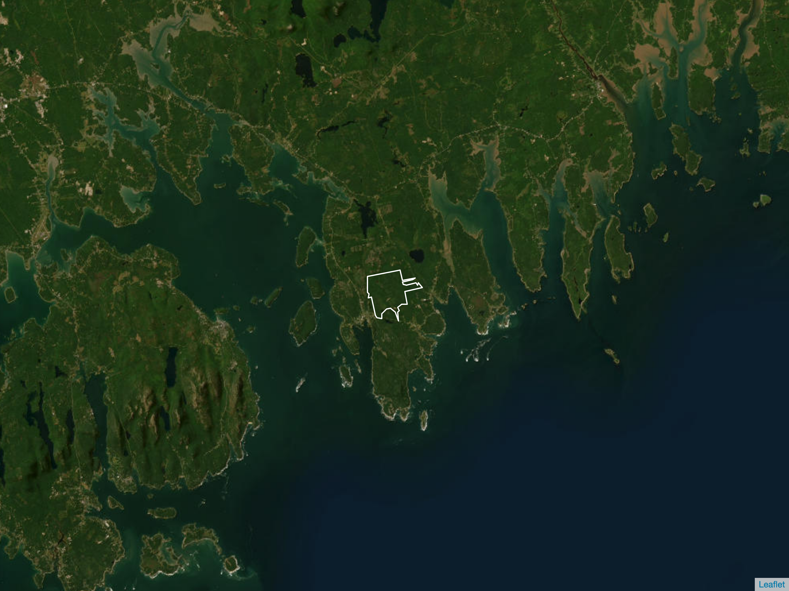

New Brunswick
Quebec
Maine
Bar Harbor
New Hampshire
Schoodic Forest
Vermont

Slide 2
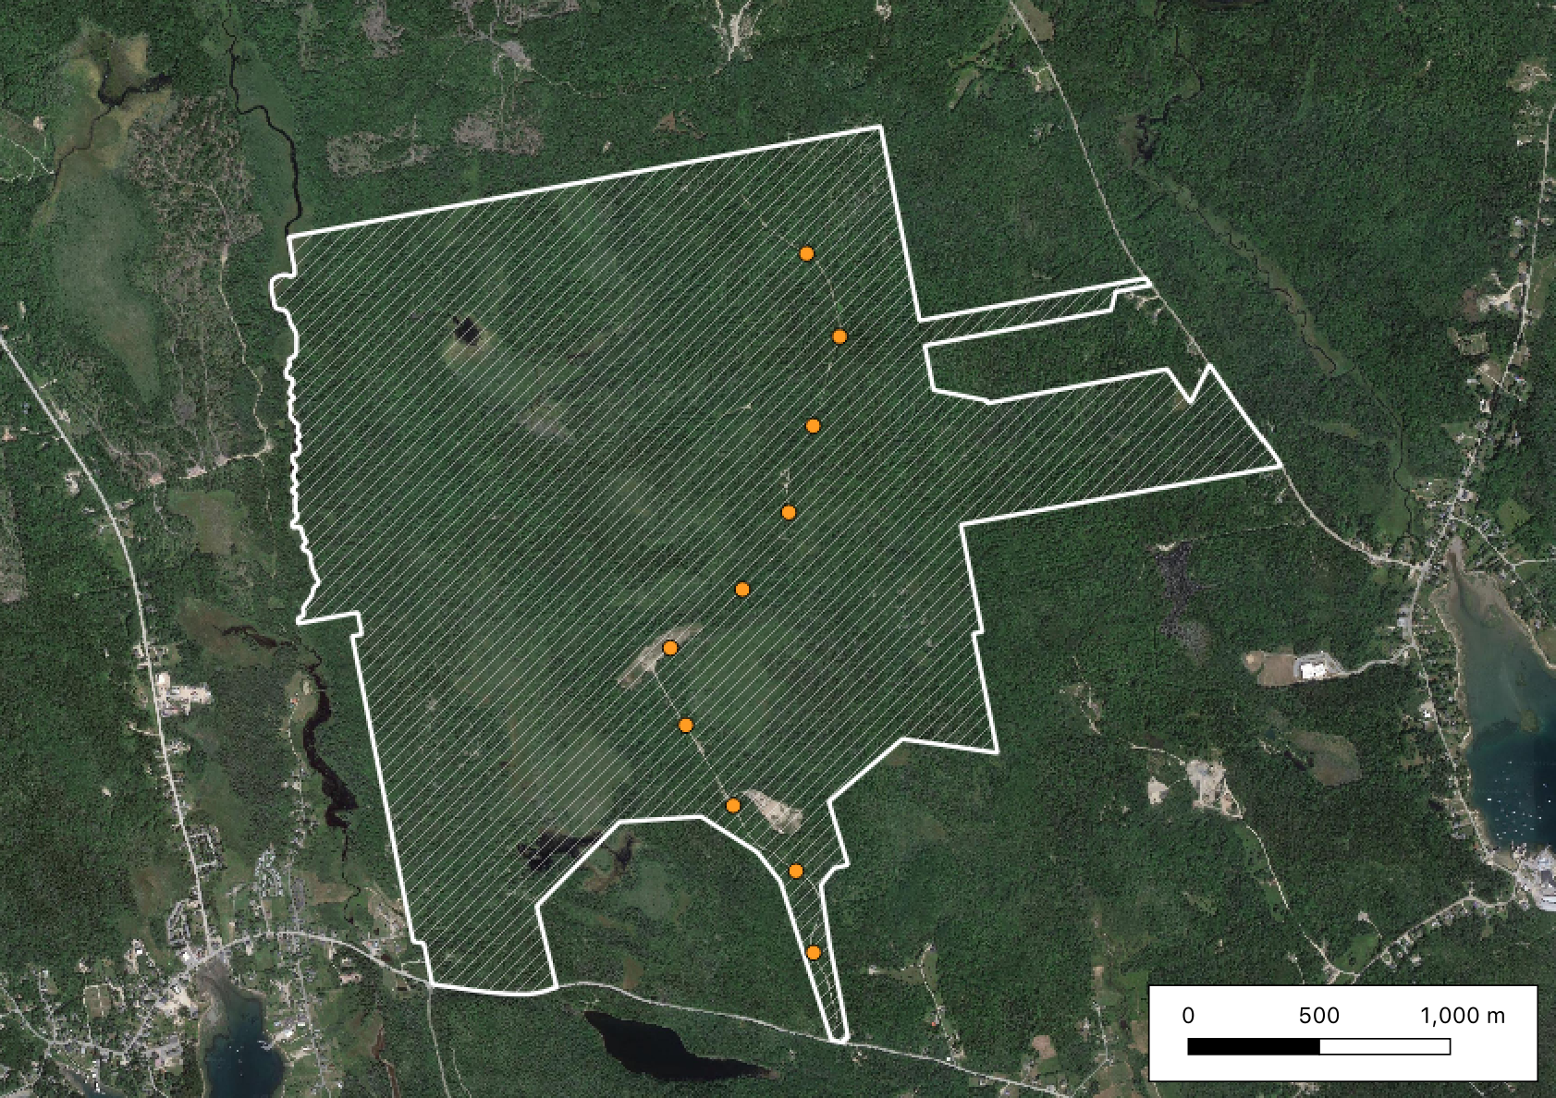
Schoodic Forest
Survey points
RC10
500m
RC1

